Slide 1


Welcome to our class 4
Teacher: Nguyen Thi Thuy
School: VXT Primary School

Slide 2
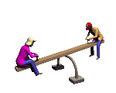
Ride a bike
Checking up:
Call two students to introduce themselves in front of class
My name is ……….I am 10 years old. I can (sing). I like (listening to music).
Dance
Speak English
Play the piano
Draw

Slide 3
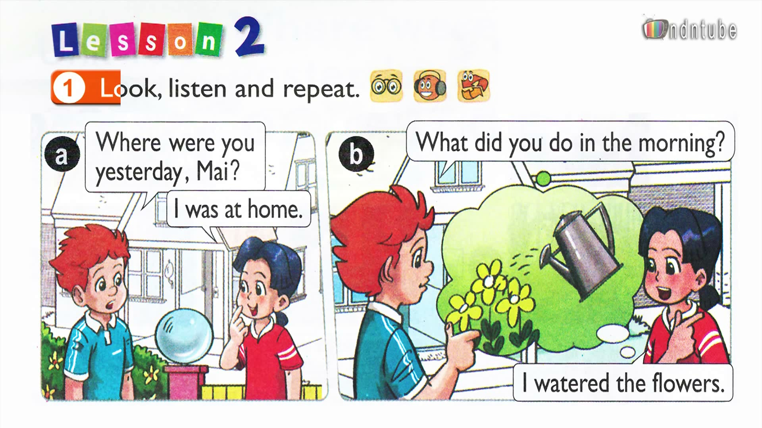

Slide 4
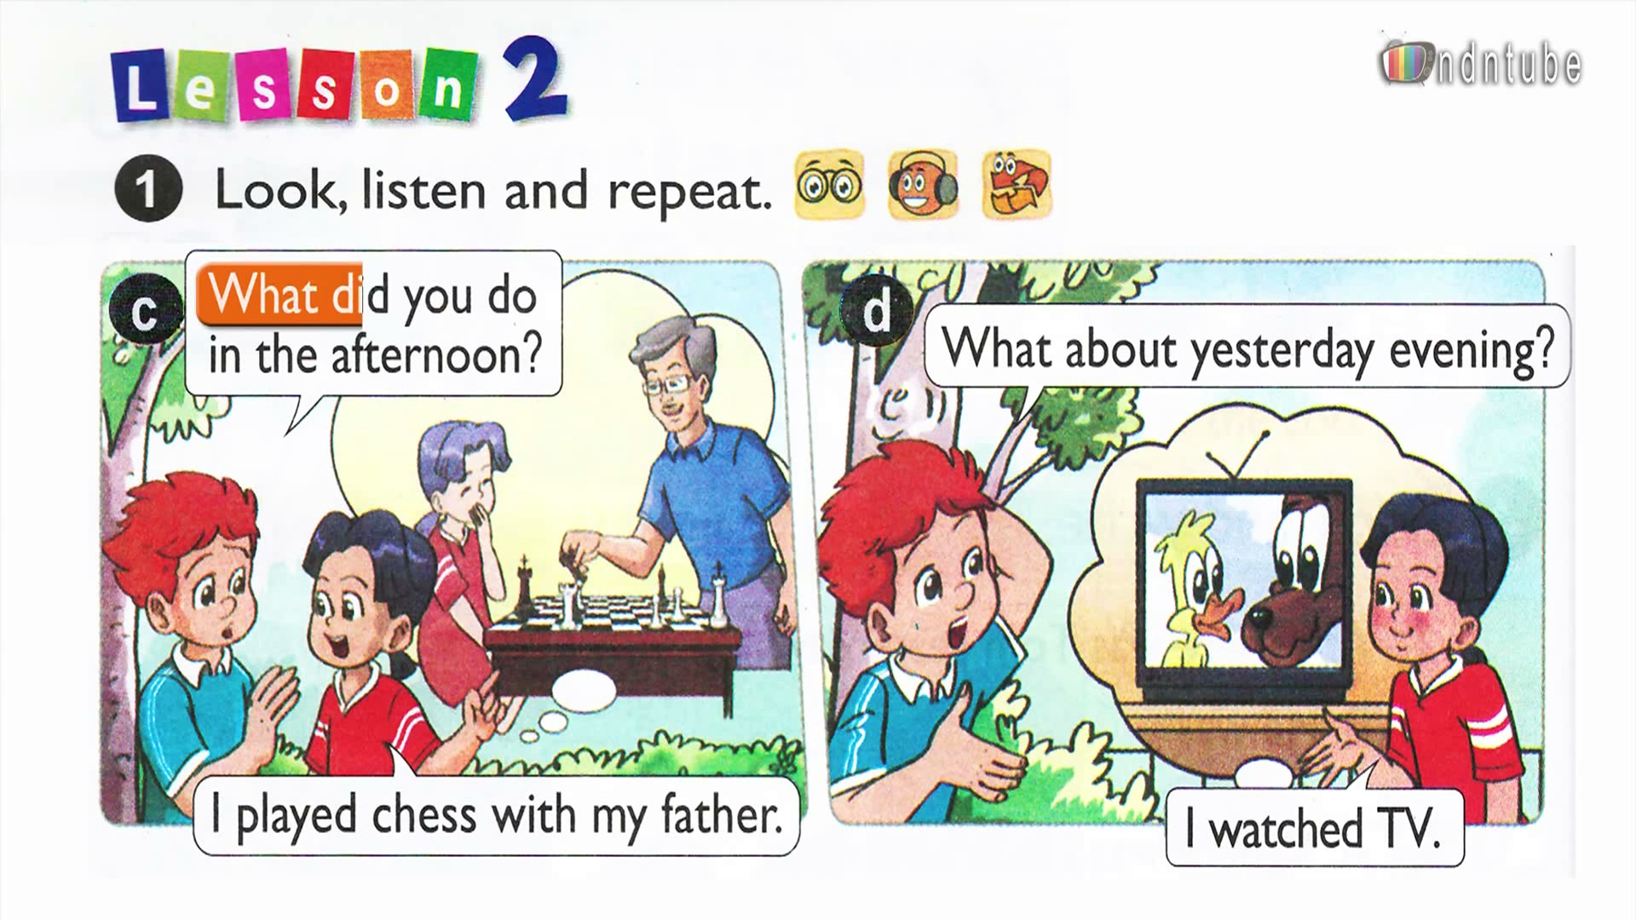

Slide 5
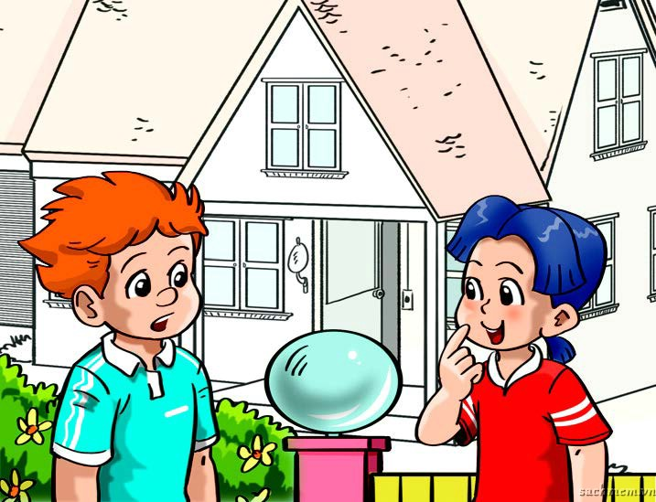
Where were you yesterday, Mai?
I was at home.
1. Look, listen and repeat.

Slide 6
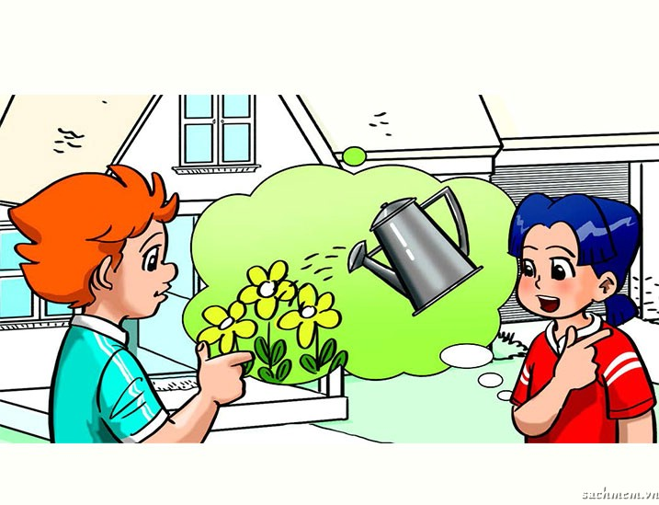
What did you do in the morning?
I watered the flowers.

Slide 7
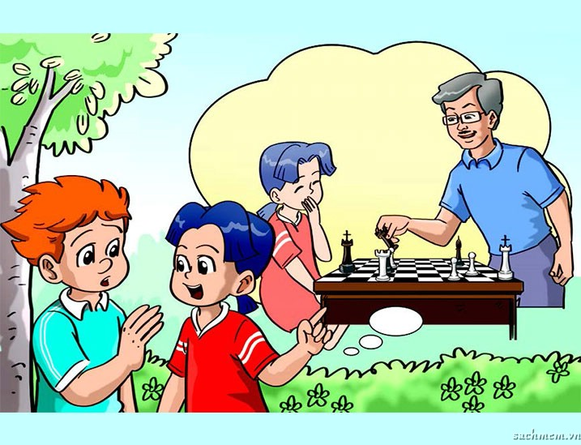
What did you do in the afternoon?
I played chess with my father.

Slide 8
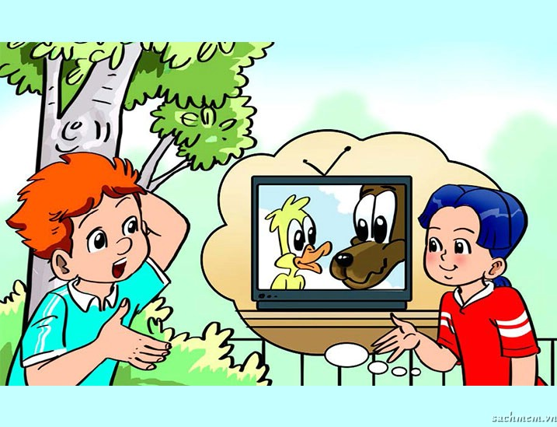
What about yesterday evening?
I watched TV.

Slide 9
Where were you yesterday, Mai?
I was at home.
What did you do in the morning?
I watered the flowers.
What did you do in the afternoon?
I played chess with my father.
What about yesterday evening?
I watched TV.

Slide 10
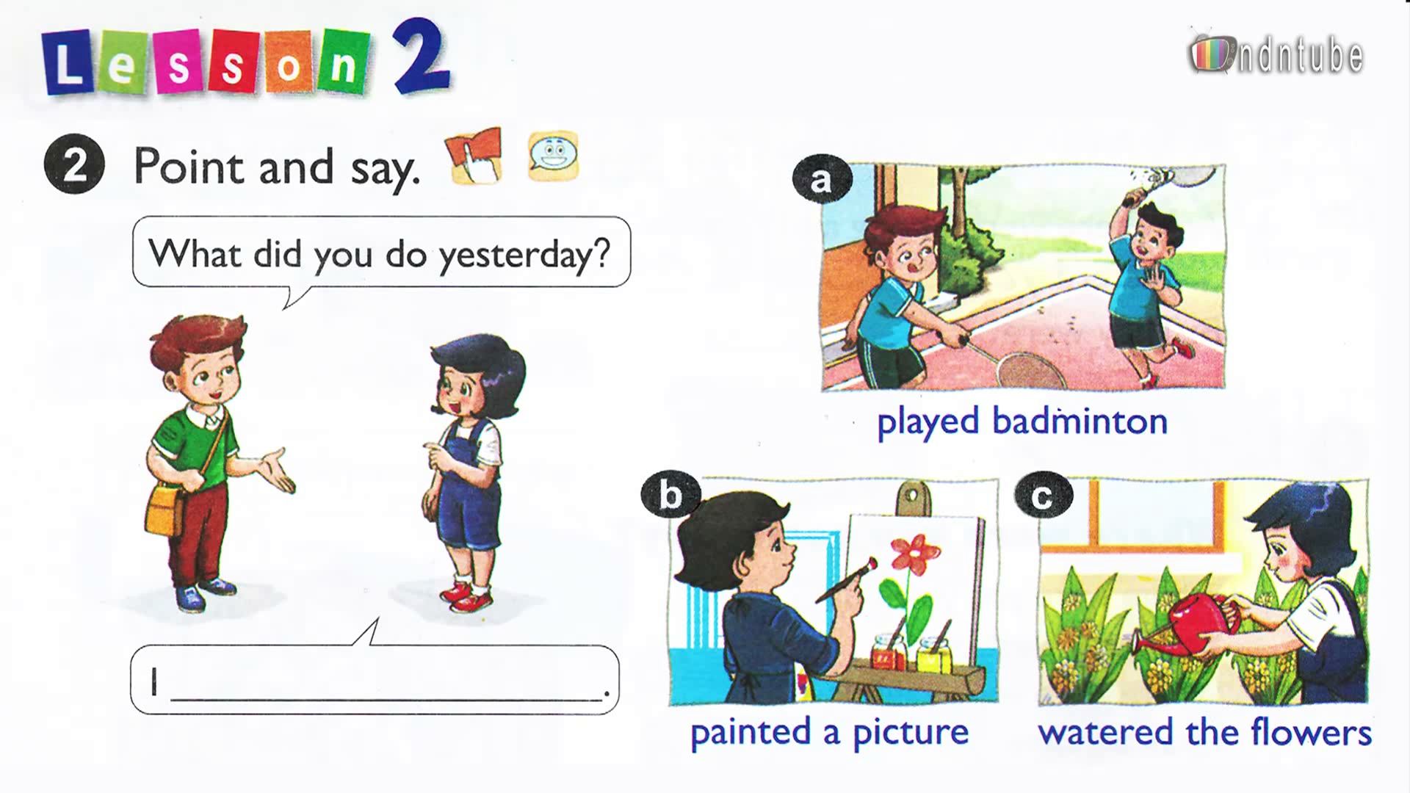

Slide 11
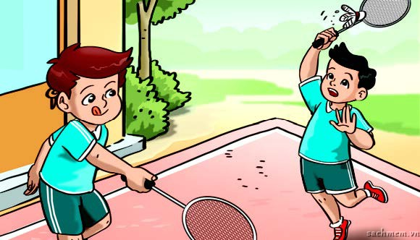
Played badminton
What did you do yesterday?

Slide 12
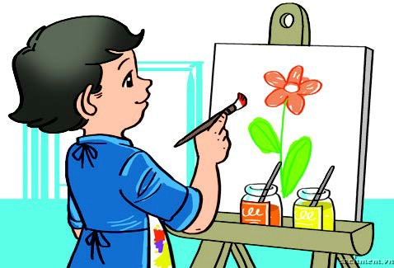
Painted a picture
What did you do yesterday?

Slide 13
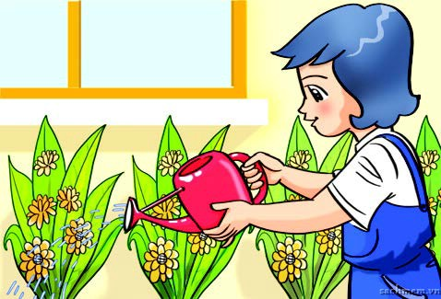
Watered the flowers
What did you do yesterday?

Slide 14
3. Let’s talk.
Where were you yesterday?
I was……………
What did you do yesterday?
I + verb- ed.
Note: Expressions for the past time:
- Yesterday morning/ afternoon/ evening.
- Last night/ week/ month/ year…

Slide 15


Team A
Gifts
lost
6
>>
1
5
3
2
8
7
4
Team B
Gifts
lost

Slide 20
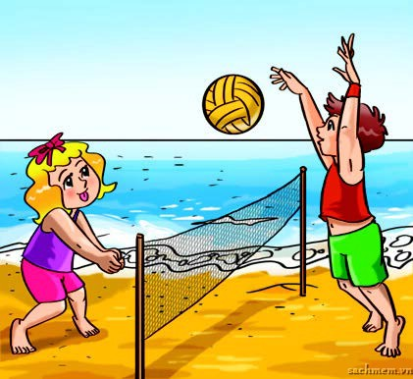

Slide 21
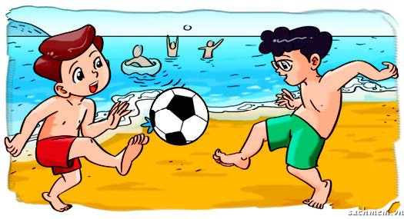

Slide 22
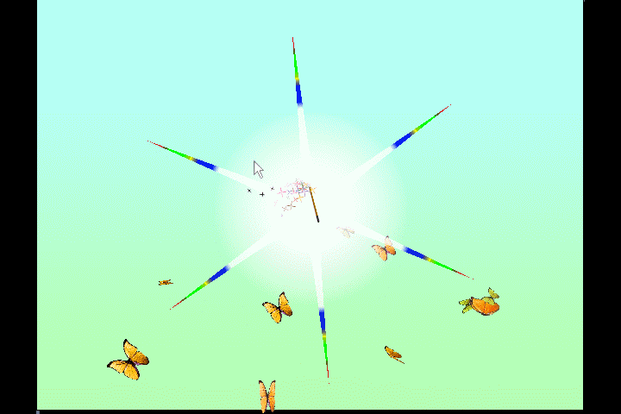

Lucky number
You get 2 gifts.

Slide 23
4. Homelink:
- Learning by heart all the new words.
- Preparing the next lesson.

Slide 24



Our lesson is over
Thank you very much

